Slide 1


Redmond High School
Parent Teacher Student association
SUPPORTING connections between home, school, and community
ENRICHING the learning environment to benefit students, staff, and families.
Notes:
Script: Welcome to Redmond High School. On behalf of the PTSA, here is a brief presentation about what we do to support RHS

Slide 2
Major Accomplishments
2021-2022
Programs and Services Supported by RHS PTSA
College scholarships for 6 graduating seniors
Water bottle filling stations
Ping pong tables in the courtyard
Outdoor tent
New Cyclorama for PAC
Updated non-fiction library books
Beautification of plant beds in front of school
Donations to RHS Help fund to help kids and families in need
Emergency response training devices & radio batteries
Reflections Art program
ACT/SAT Practice Tests
Staff appreciation events throughout the year
Washington State PTA Essay Contest and Game Development Contest
Notes:
Here is a list of just some of our accomplishments last year. I want to highlight a few major ones:
After a few years of working on logistics with the District, we were able to install 2 water bottle filling stations. This was a key initiative for our Sustainability group and reduces single use plastic water bottles.
Multi-year task of sprucing up the plant beds with native, sustainable vegetation took place in the spring
Provide an outdoor tent and ping pong tables to provide space to facilitate student interaction outdoors while we are still dealing with the risks and impacts of COVID
We also provide donations to RHS Help, have regular staff appreciate events, and provide low cost ACT/SAT practice tests

Slide 3
Benefits of membership
Your membership helps support school programs for students, teachers, and families
Every member counts toward representation at the state level, more members = a louder voice in support of our students
Get great benefits and discounts including year-round savings with WSPTA partners like Great Wolf Lodge, Seattle Symphony, Office Depot, and many more!
Please join today by stopping by the PTSA table in front of the office or going online to: www.redmondhsptsa.org
Notes:
Membership helps support PTSA programs on a local level for students, teachers, and families and on a state level
Plus, there are benefits of membership as listed here

Slide 4
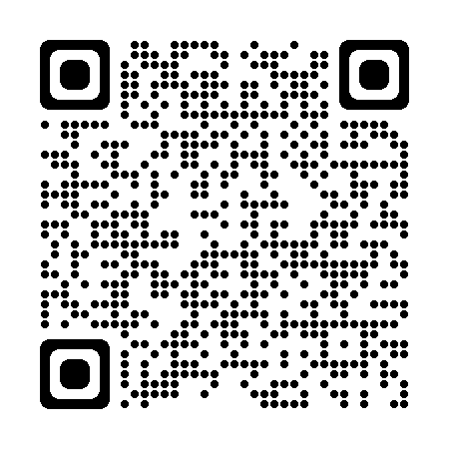
Get involved!
Join today!
Pass the Hat fundraiser
Join/Chair a committee
All can be done at www.redmondhsptsa.org, at the PTSA table tonight, or using this QR code:

Slide 5
Thank you and have a great year!
2022-2023 Ptsa Board Members:
Branda Andrade, President
Roo Hall, Secretary
Felice Nightengale, Treasurer
Judy Kaethler, VP Communications
Meredith Cain, VP Student Programs
Satin Brennan, VP Sustainability
Lisa Frost, VP Hospitality
Pam McBain, VP Volunteers
Becky Mitchell, VP Ways & Means (appointed)
Contact us at [position]@redmondhsptsa.org (e.g., vp_communications@redmondhsptsa.org)

